Slide 1
UML MODELING TOOLS: AN INTRODUCTION
By:
Dr. Ritika Wason
Associate Professor
BVICAM

Slide 2
UML
UML ≈ UNIFIED MODELING LANGUAGE
Unified because it combines main preceding Object Oriented methods(Booch by Grady Booch, OMT by Jim Rumbaugh and OOSE by Ivar Jacobson).
Modeling because it is primarily used for visually modeling systems.
Language because it offers a syntax through which to express modeled knowledge.
Main diagram types:
structural: class, component, deployment diagrams
behavioral: use case, sequence, statechart diagrams

Slide 3
VISUAL MODELING
Increasing complexity of highly competitive and ever-changing business environments offer challenges to system developers. Models help them organize,visualize,understand and create complex things.
Visual Modeling is defined as the mapping of real world processes of a system to a graphical representation.
Models are useful for understanding problems, improving team communication, understanding system requirements, cleaner designs and more maintainable systems.

Slide 4
VISUAL MODELING(Contd.)
Increasing software complexity has made understanding them in entirety difficult. Hence, using modeling a developer can begin by looking at the big picture without being caught up in the details.
A model is hence an ideal way to portray the abstractions of a complex problem by filtering out the nonessential details.

Slide 5
VISUAL MODELING(Contd.)
Software Models ≈ Building Blueprints
UML (Unified Modeling Language is the communication standard for visual modeling. It provides a smooth transition between business and computer domain.
Advantages of UML-tools over drawing-tools
uniform notations
certain checks provided
UML-tools provide add-ons

Slide 6
UML Tools
Commercial :Rational Rose (IBM), Together Designer (Borland), Rhapsody (I-Logix), Poseidon (Gentleware)
Free: Omondo, Visual Paradigm (Visual Paradigm)
Open source: ArgoUML (Tigris), StarUML
And many, many more…

Slide 7
MODELING WITH RATIONAL ROSE
Rational Rose is the visual modeling software solution that allows one to create, analyze, design, view and manipulate components.
We can use Rose to :
Graphically depict overview of system behavior: Use-Case diagrams
Object interactions organized around objects and their links to one another: Collaboration diagrams
Analysis techniques for classes with significant dynamic behavior: State-chart diagrams
Class operations or business process workflows: Activity Diagrams

Slide 8
MODELING WITH RATIONAL ROSE (Contd.)
Hence, Rational Rose provides the notation to specify and document the system architecture.
Logical Architecture → Class Diagram
Component Architecture → Component Diagram
Deployment Architecture → Deployment Diagrams

Slide 9
NOTATIONS
Play an important role in any application development activity(glue holding the process together)
UML is a robust notation from analysis to design.
Elements of notation like use cases, classes, associations, aggregations, inheritance etc are used during analysis. Other elements like containment indicators and properties are introduced during design.

Slide 10
NOTATIONS(Contd.)
Roles:
Communicates not so obvious decisions(cannot be inferred from code).
Provides semantics that capture important strategic and tactical decisions.
Offers concrete forms and tools that can be manipulated.

Slide 11
GETTING STARTED WITH RATIONAL ROSE
One can use Rational Rose’s graphical user interface to display, create, modify, manipulate, and document the elements in a model using these windows:
Application window
Browser window
Documentation window
Diagram window
Overview window
Specification window
Log window
Rational Rose displays the diagram, specification, and documentation windows within the application window. The log window is a dockable window you can move, dock or undock, or close.

Slide 12
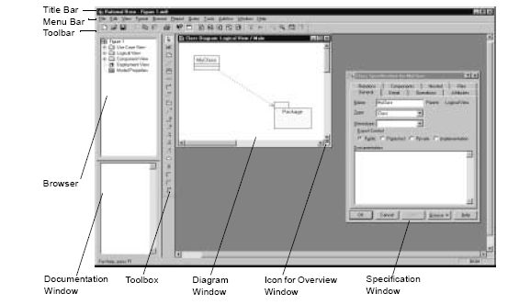
RATIONAL ROSE WINDOWS

Slide 13
STAR UML : INTRODUCTION
Free and open source, Supports
Windows only, UML 2.0 and XMI
Mostly written in Delphi. However, is a multilingual project. Formerly known as Agora Plastic or Plastic.
all diagram types
diagram printing
code generation (C++, C#, Java)
EJB and GoF pattern application
Download: staruml.sourceforge.net
Code: staruml.tigris.org

Slide 14
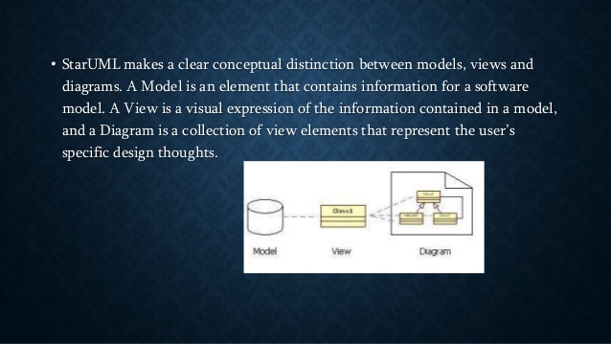
STAR UML

Slide 15
STAR Uml supports the following diagram types:
Use case diagram
Class diagram
Sequence Diagram
Collaboration Diagram
Statechart Diagram
Activity Diagram
Component Diagram
Deployment Diagram
Composite Structure Diagram
Communication Diagram
Robustness Diagram
Star UML also has a model verification feature. You can export diagram in different formats (eg: jpg, bmp, wmf etc). It supports a patterns approach and import of Rational Rose files.

Slide 16
PROS/CONS
Pros/Features
Supports most of the diagrams specified in UML2.0.
Very rich feature set and formatting option.
Ability to generate source code from the UML diagram.
Reverse engineer the existing code into the UML diagrams.
Supported languages:C++, C# and Java
Fast load time/execution time compared to other UML tools.
Familiar Visual Studio like interface
Support exporting diagrams into JPG/XMI formats
Used by Samsung, Intel, Accenture, LG, Nortel Networks, Ericsson, GE, Infosys.

Slide 17
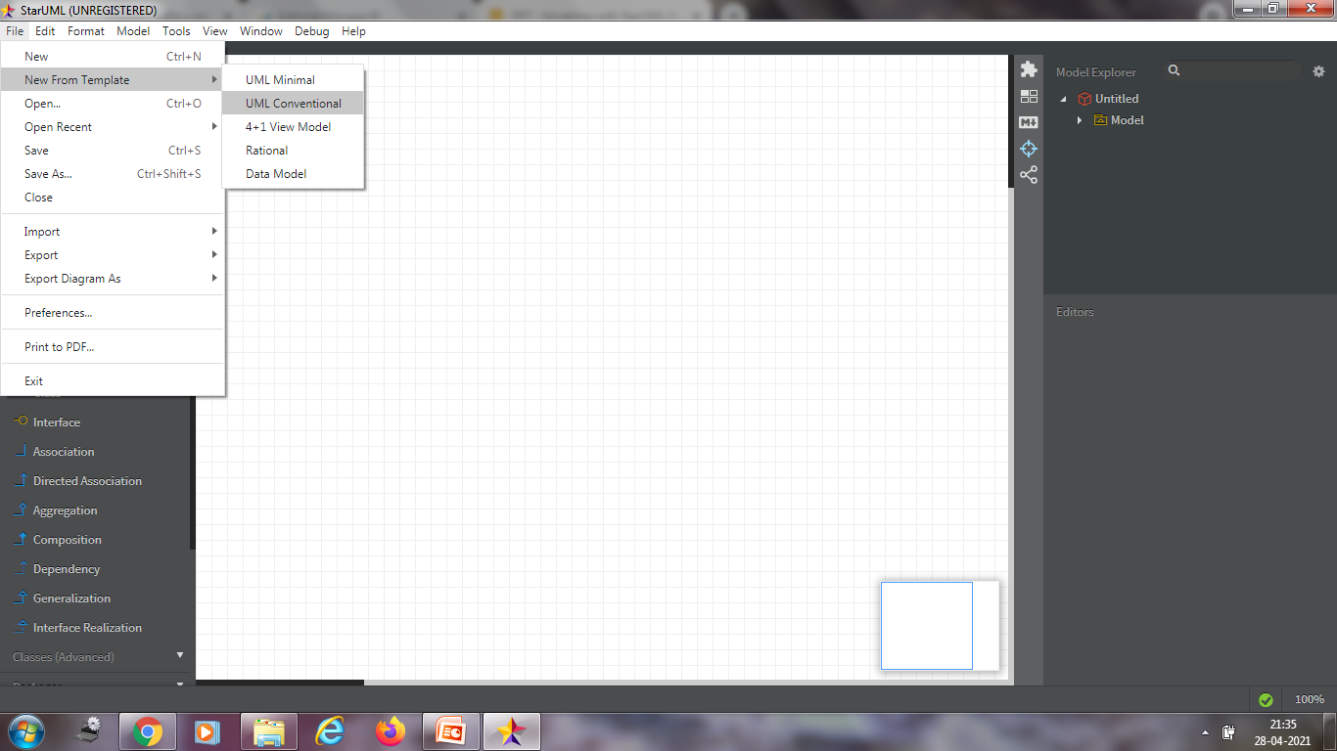
Create New Project
Select File->New from Template->4+1 view menu.

Slide 18
USE-CASE DIAGRAM
Use-case diagrams present a high-level view of how a system is used as seen from an outsider’s (or actor’s) perspective. These diagrams graphically depict system behavior (also known as use cases). A use-case diagram may depict all or some of the use cases of a system.
A use-case diagram can contain:
Actors (“things” outside the system).
Use cases (system boundaries identifying what the system should do).
Interactions or relationships between actors and use cases in the system including the associations, dependencies, and generalizations.

Slide 19
USE-CASE DIAGRAM
Use-case diagrams can be used during analysis to capture the system requirements and understand how the system should work. During the design phase, use-case diagrams can be used to specify the behavior of the system as implemented.
You can create or display a use-case diagram in one of three ways:
Click Browse > Use Case Diagram.
On the toolbar, double-click the use-case diagram icon.
In the browser, double-click the use-case diagram icon.

Slide 20
ACTORS
Actors represent system users. They help define the system and give a clear picture of what the system should do. It is important to note that an actor interacts with, but has no control over, the use cases.
An actor is someone or something that:
Interacts with or uses (but is not part of) the system.
Provides input to and receives information from the system.
Is external to the system and has no control over the use cases.
A primary actor uses the system's primary functions (e.g. a bank cashier);
A secondary actor uses the system's secondary functions (e.g. a bank manager, system administrator);

Slide 21
USE CASE
A use case is a sequence of events (transactions) performed by a system in response to a trigger initiated by an actor. A use case contains all the events that can occur between an actor-use case pair, not necessarily the ones that will occur in any particular scenario.
In its simplest form, a use case can be described as a specific way of using the system from a user’s (actor’s) perspective. A use case also illustrates:
A pattern of behavior the system exhibits.
A sequence of related transactions performed by an actor and the system.

Slide 22
RELATIONSHIPS
Relationships show interactions between actors and use cases. Association, dependency, and generalization relationships can be drawn from an actor to a use case. The generalize relationship can be drawn between actors.

Slide 23
ASSOCIATION
An association provides a pathway for communication between use cases and actors. Associations are the most general of all relationships and the most semantically weak. If two objects are usually considered independently, the relationship is an association. The association name and its stereotype are typically verbs or verb phrases and are used to identify the type or purpose of the relationship. There are two different types of associations in use-case diagrams: uni-directional and bi-directional. Uni-directional association: By default, associations in use cases are uni-directional and drawn with a single arrow at one end of the association. The end with the arrow indicates who or what is receiving the communication. Bi-directional association: To change the communication to be bi-directional, double-click the association to view the Association Specification. Click the appropriate Role A (or B) Detail tab, select the Navigable check box, and click Apply. You have now made the association bi-directional. The graphic changes from a line with an arrow at one end to a line with no arrow. If you prefer, you can also customize the toolbox to include the bi-directional tool in the use-case toolbox.

Slide 24
DEPENDENCY
A dependency is a relationship between two model elements in which a change to one model element will affect the other model element. Use a dependency relationship to connect model elements with the same level of meaning. Typically, on class diagrams, a dependency relationship indicates that the operations of the client invoke operations of the supplier. You can connect model elements with dependencies on any diagram except state machine diagrams and object diagrams. For example, you can connect a use case to another use case, a package to another package, and a class to a package. Dependencies are also used on component diagrams to connect model elements.

Slide 25
DEPENDENCY(Contd.)
Extend Stereotype
An extend relationship is a stereotyped relationship that specifies how the functionality of one use case can be inserted into the functionality of another use case. You can place extend stereotypes on all relationships. However, most extend stereotypes are placed on dependencies or associations. Extend relationships are important because they show optional functionality or system behavior.

Slide 26
DEPENDENCY(Contd.)
Include Stereotype
An include relationship is a stereotyped relationship that connects a base use case to an inclusion use case. An include relationship specifies how behavior in the inclusion use case is used by the base use case. Include relationships are important because they represent that the inclusion use case functionality is used by the base use case.

Slide 27
GENERALIZATION
A generalization relationship is a relationship between a more general class or use case and a more specific class or use case. A generalization is shown as a solid-line path from the more specific element to a more general element. The tip of a generalization is a large hollow triangle pointing to the more general element. You can place a stereotype on any generalization through the Generalization Specification. However, three common stereotypes for generalizations are extends, includes, and generalization.

Slide 28
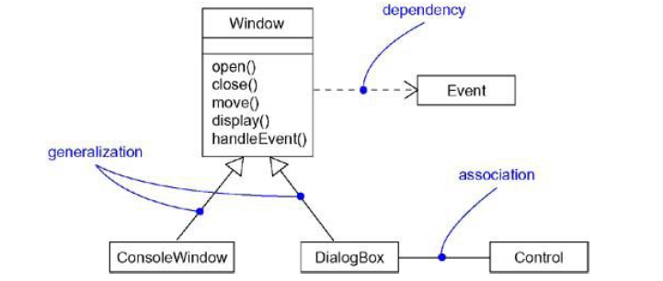

Slide 29
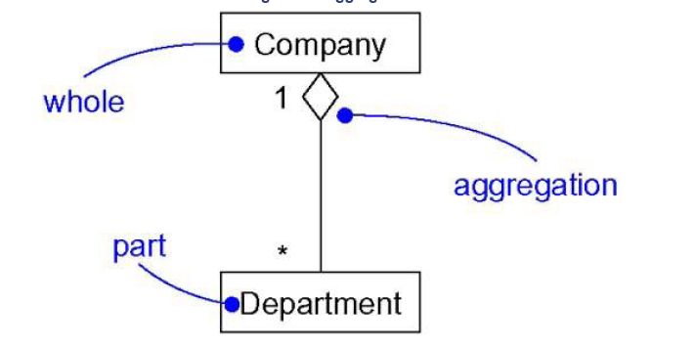
AGGREGATION
A plain association between two classes represents a structural relationship between peers, meaning that both classes are conceptually at the same level, no one more important than the other. Sometimes, you will want to model a "whole/part" relationship, in which one class represents a larger thing (the "whole"), which consists of smaller things (the "parts"). This kind of relationship is called aggregation, which represents a "has-a" relationship, meaning that an object of the whole has objects of the part. Aggregation is really just a special kind of association and is specified by adorning a plain association with an open diamond at the whole end,

Slide 30
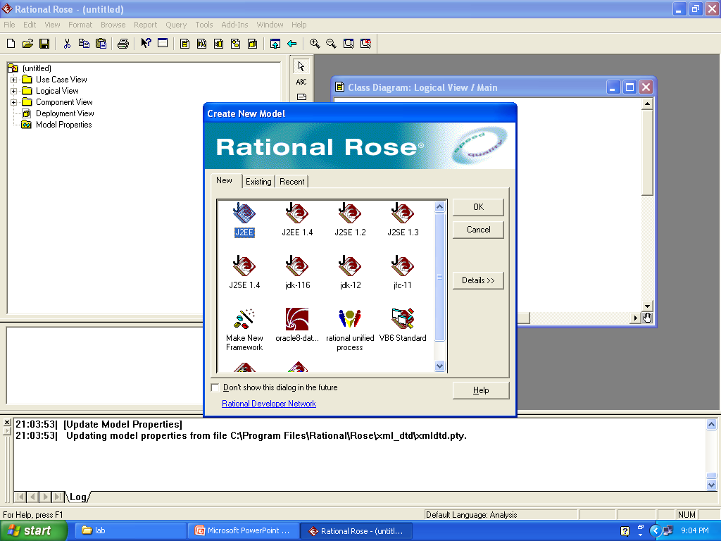
USING ROSE
Click on Start→All Programs→Rational Software → Rational Rose Enterprise Edition.

Slide 31
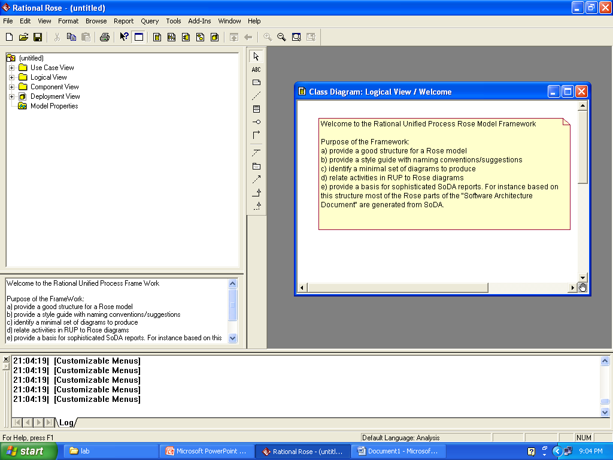
USING ROSE(Contd.)
Select Rational Unified Process → Ok.

Slide 32
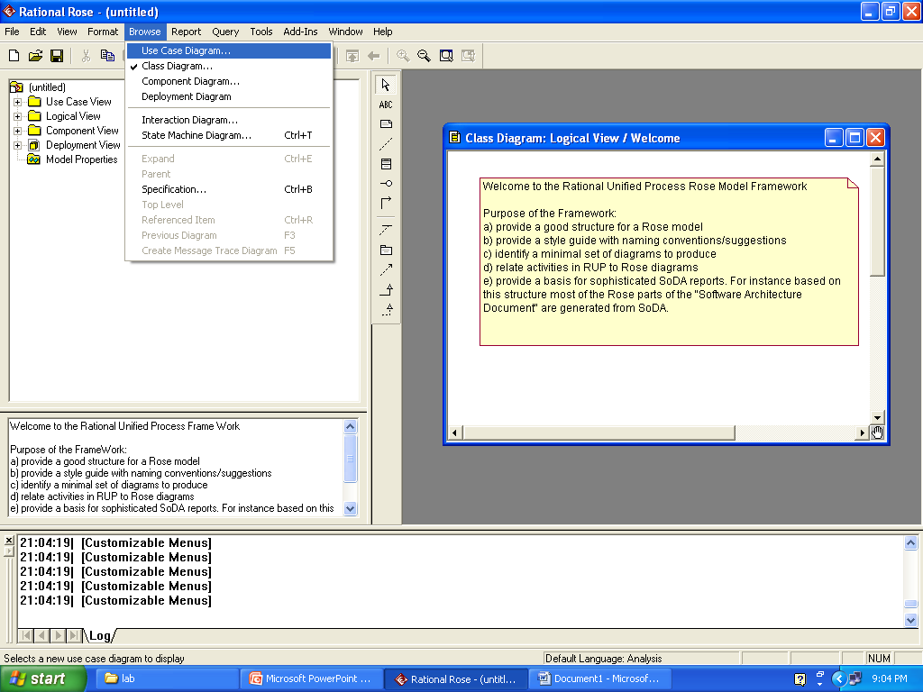
USING ROSE(Contd.)
Click Browse → Use Case Diagram.

Slide 33
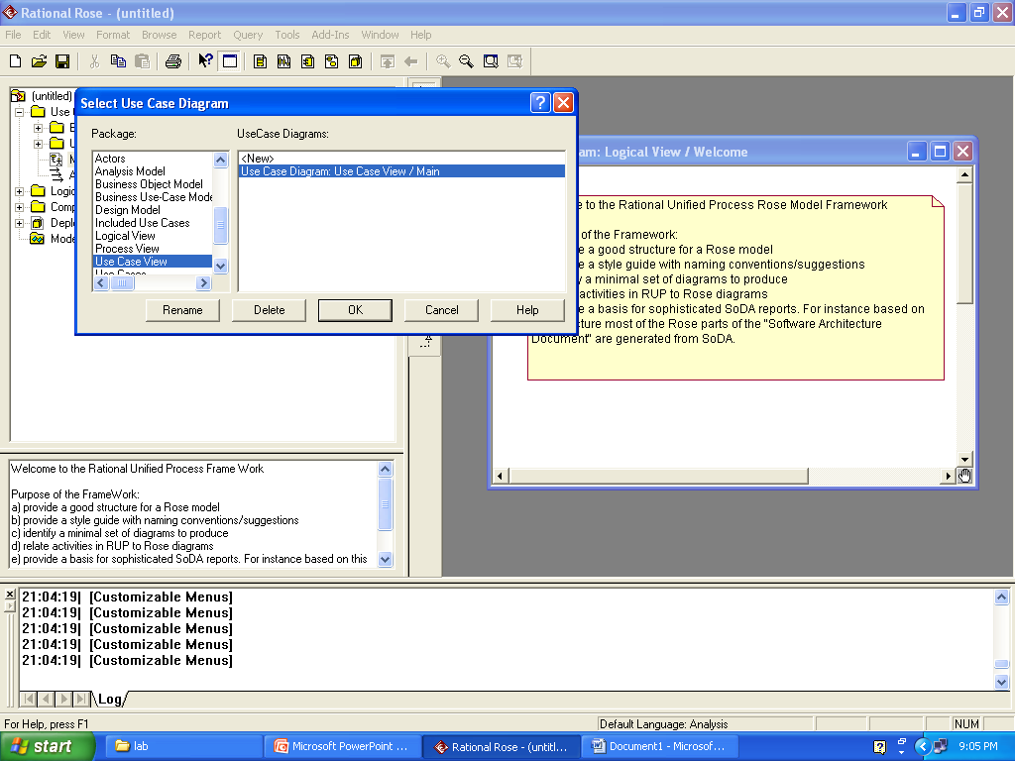
USING ROSE(Contd.)

Slide 34
WORKSHOP EXERCISE 1
Create a simple UCD (i.e. no “uses” or “extends” relationships) for a course registration system described as follows:
“The course registration system should allow students to register for and drop courses. The system’s administrator should be able to add and delete courses from the system as well as to cancel planned courses. If a planned course is cancelled the relevant instructor should be notified through the system.”

Slide 35
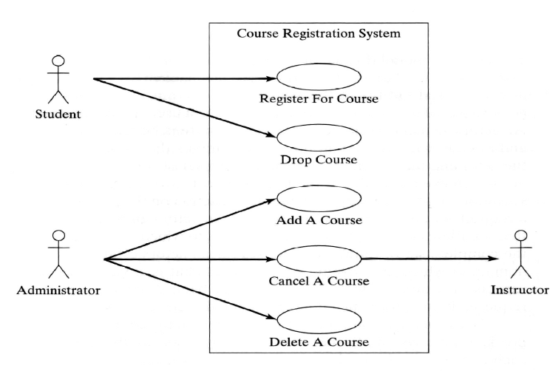
USE CASE DIAGRAM

Slide 36
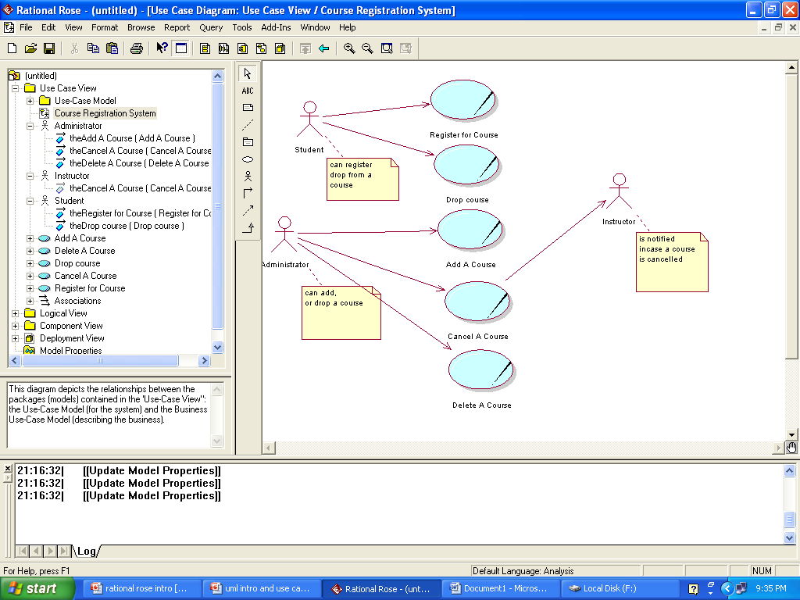
USE CASE DIAGRAM(course registration .mdl)

Slide 37
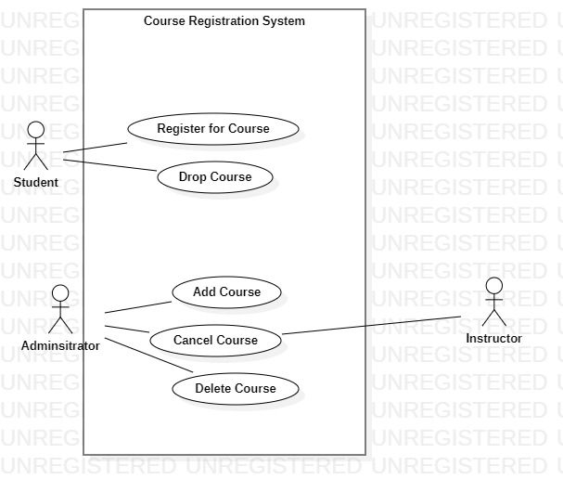
USE CASE DIAGRAM(course registration .mdj)

Slide 38
WORKSHOP EXERCISE 2
• After client interview the following system
scenarios were identified:
• A customer buys a product
• The supplier restocks the machine
• The supplier collects money from the machine
• On the basis of these scenarios, the following
three actors can be identified:
• Customer; Supplier;

Slide 39
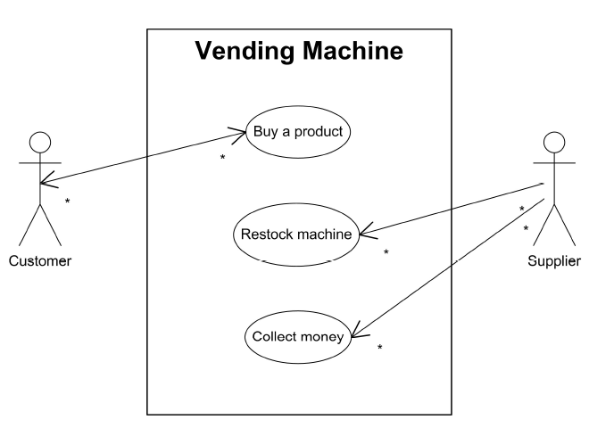
USE CASE DIAGRAM

Slide 40
WORKSHOP EXERCISE 3
Digital sound-recorder (Dictaphone)
Based on: Ivan Porres Paltor, Johan Lilius:
Digital Sound Recorder: A case study on designing embedded systems using the UML notation
Main features:
Capacity for 10 different messages, each max. of 2 minutes
Messages can be recorded, played back and deleted
Messages can be locked/unlocked to prevent unwanted deletion/overwriting
LCD display

Slide 41
Problem Statement
The recorder stores up to 10 messages
Each message is max. 2 minutes long
The user can record message
Recording of a message ends after 2 minutes or when the user stops recording
Recording destroys the original message at chosen slot
Sufficient level of battery is checked before recording message
Message of a given slot can be replayed
Sufficient level of battery is checked before replaying message
Messages can be locked/unlocked
Locked messages cannot be deleted or over-written by recording to the same slot
User uses LCD display and buttons to interact with recorder

Slide 42
ACTIVITY DIAGRAMS
Use cases show what your system should do. Activity diagrams allow you to specify how your system will accomplish its goals.
Activity diagrams show high-level actions chained together to represent a process occurring in your system. For example, you can use an activity diagram to model the steps involved with creating an account.
Activity diagrams provide a way to model the workflow of a business process. You can also use activity diagrams to model code-specific information, such as a class operation. Activity diagrams are very similar to a flowchart because you can model a workflow from activity to activity. An activity diagram is basically a special case of a state machine in which most of the states are activities and most of the transitions are implicitly triggered by completion of the actions in the source activities.

Slide 43
ACTIVITY DIAGRAMS(Contd.)
Each activity represents the performance of a group of actions in a workflow. Once the activity is complete, the flow of control moves to the next activity or state through a transition.
A unique activity diagram feature is a swimlane that defines who or what is responsible for carrying out the activity or state. It is also possible to place objects on activity diagrams. The workflow stops when a transition reaches an end state.
You can attach activity diagrams to most model elements in the use case or logical views. Activity diagrams cannot reside within the component view.

Slide 44
CREATING AN ACTIVITY DIAGRAM
To create an activity diagram:
1 In the browser, right-click any model element except for attributes, associations, or model elements that appear in the component view.
2 Click New > Activity Diagram.
3 Rename or double-click to display the NewDiagram icon in the browser.
Another way to create an activity diagram:
1 Click the Browse State Machine Diagram button from the toolbar.
2 Click New.
3 Select the Activity Diagram check box in the New State Machine dialog box.
4 Enter the activity diagram title.
5 Click OK.

Slide 45

ACTIVITY DIAGRAMS(Contd.)
Tool Name | Symbol
Decisions
Swimlanes
Activities (Lozenge)
Start state
End state
Transitions
Synchronizations
Self Transition

Slide 46
ACTIVITY DIAGRAMS(Contd.)
An activity represents the performance of a task within the workflow. It is similar to a state but expresses the intent that there is no significant waiting for events in an activity.
Start state explicitly shows the beginning of a workflow on an activity diagram.
End state represents the final or terminal state on an activity diagram.
State transitions show what activity follows after another.
Decision is a point in an activity diagram where guard conditions are used to indicate different possible transitions.
Synchronization bar allows one to show concurrent threads in a workflow of a use case.
Swimlane is used to partition an activity diagram to help us better understand who or what is initiating the activity.

Slide 47
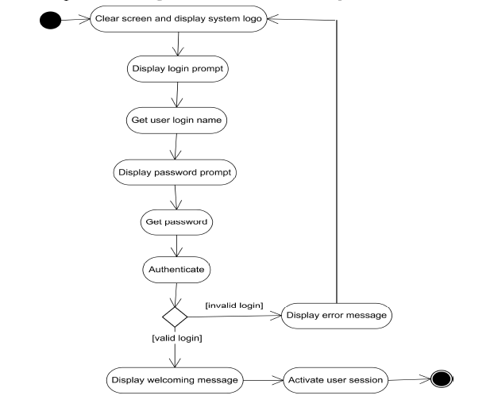
SAMPLE ACTIVITY DIAGRAM
(Login Module)

Slide 48
WORKSHOP EXERCISE 3
When we receive an order, we check each line item of
the order to see if we have the goods in stock. If we do,
we assign the goods to the order. If this assignment
sends the quantity of goods in stock below the reorder
level, we reorder the goods. While we are doing this,
we check to see if the payment is OK. If the payment is
OK and we have the goods in stock, we dispatch the
order. If the payment is Ok but we do not have the
goods, we leave the order waiting, if the payment is not
OK, we cancel the order.

Slide 49
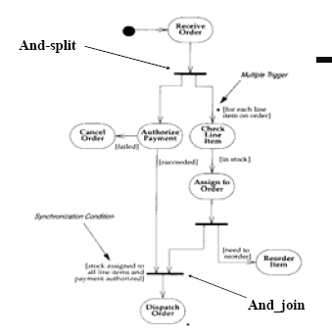
SUGGESTED SOLUTION

Slide 50
WORKSHOP EXERCISE 4
Create activity diagrams for any of the use-cases of course registration system described earlier?

Slide 51
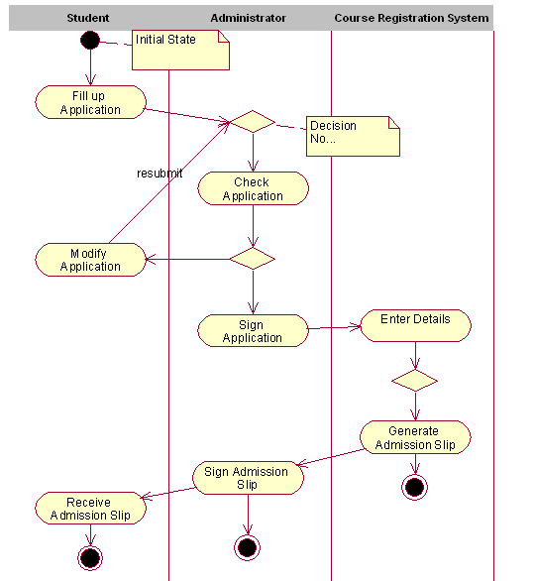

Slide 52
CLASS DIAGRAM
Class diagrams are the most common diagram found in modeling object- oriented systems. A class diagram shows a set of classes, interfaces, and collaborations and their relationships.
You use class diagrams to model the static design view of a system.
Class diagrams are also the foundation for a couple of related diagrams: component diagrams and deployment diagrams.
Class diagrams are important not only for visualizing, specifying, and documenting structural models, but also for constructing executable systems through forward and reverse engineering.

Slide 53
CLASS DIAGRAM
Class diagrams commonly contain the following things:
· Classes
· Interfaces
· Collaborations
· Dependency, generalization, and association relationships
Like all other diagrams, class diagrams may contain notes and constraints.
Class diagrams may also contain packages or subsystems, both of which are used to group elements of your model into larger chunks. Sometimes, you'll want to place instances in your class diagrams, as well, especially when you want to visualize the (possibly dynamic) type of an instance.

Slide 54
WORKSHOP EXERCISE 5
Draw a class diagram for the instruction system of a school. The school has various departments. Students enroll in the school, to attend one or more courses. Instructors belong to one or more departments and teaches a particular course. The chairperson is also a member of all the departments.

Slide 55
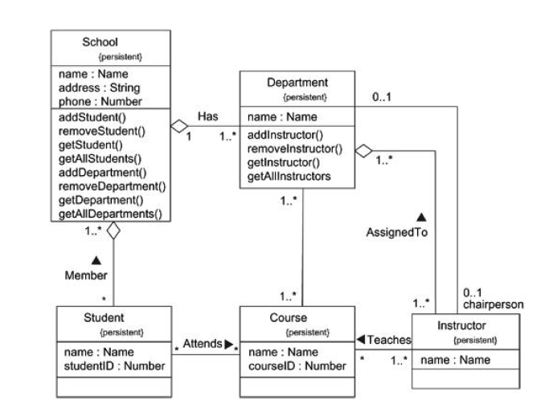

Slide 56
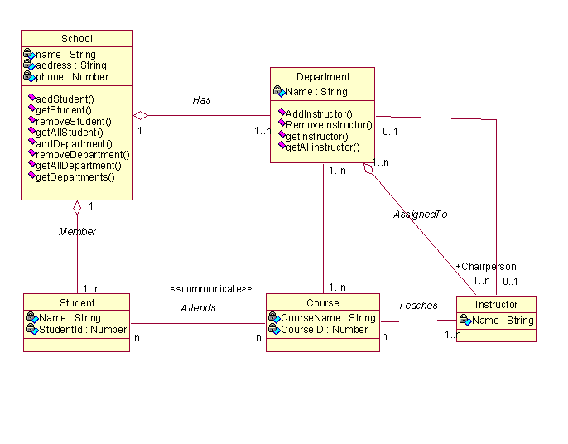
CLASS DIAGRAM: UNIFIED VIEW

Slide 57
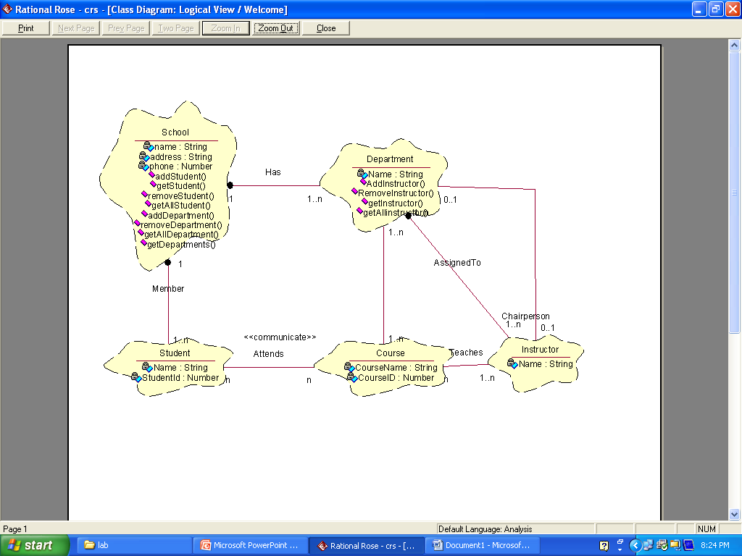
CLASS DIAGRAM: BOOCH VIEW

Slide 58
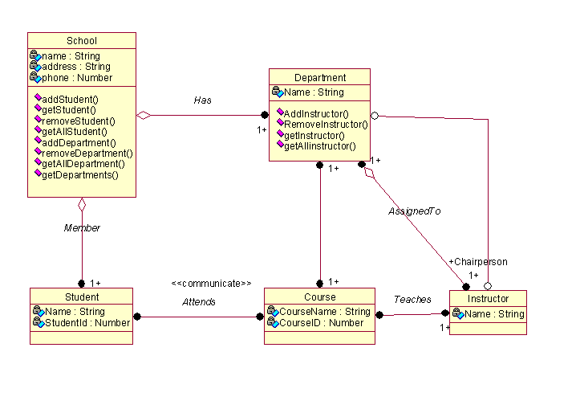
CLASS DIAGRAM:OMT VIEW

Slide 59
WORKSHOP EXERCISE 6
A Company has many departments and offices. Each department is represented by a particular office. One of the offices is also the headquarter of the company. Every department has a manager and many other people working in it. The company information system stores records of each person like name, job title and contact information giving each employee a unique employeeid. The interface IsecureInformation also stores the personnel record of each employee. Draw an appropriate class diagram for the above case.

Slide 60
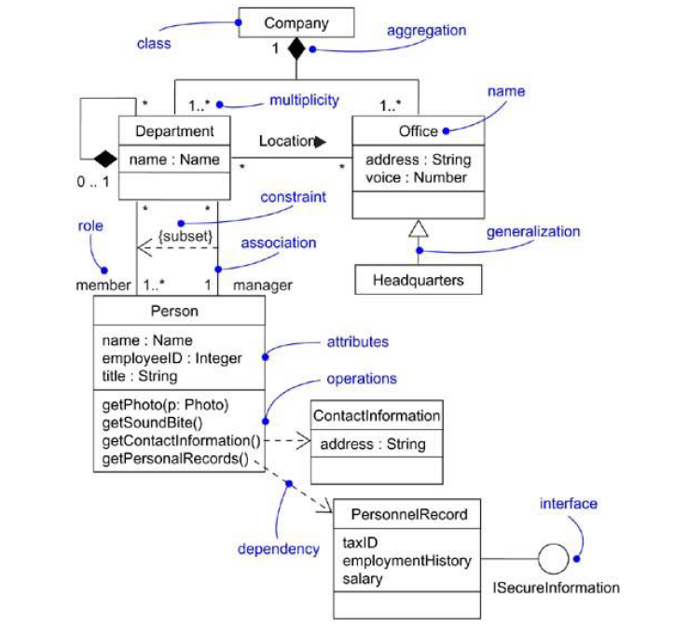

Slide 61
STATE-CHART DIAGRAMS
The state/activity model icon that appears in the browser can be thought of as a “container” for state chart and activity diagrams and all of their model elements.
A state machine can be defined as a behavior that specifies the valid sequences of activities that an object or interaction goes through during its life in response to events, together with its responses and actions.
Rational Rose automatically creates one state/activity model when you create a state chart or activity diagram. A state/activity model can be relocated to a new owner, such as a class operation or a use case, by dragging it to a new location in the browser. Rational Rose limits you to only one state/activity model per owner.

Slide 62
CREATING AND DISPLAYING A STATE MACHINE DIAGRAM
To create a state/activity model:
1 Click Browse > State Machine Diagram.
2 Double-click New.
3 Name the diagram.
4 Specify the type of diagram you want to create: Activity or State chart.
5 Click OK.

Slide 63
STATE-CHART DIAGRAMS
State chart diagrams model the dynamic behavior of individual classes or any other kind of object. They show the sequences of states that an object goes through, the events that cause a transition from one state or activity to another, and the actions that result from a state or activity change.
State chart diagrams are closely related to activity diagrams. The main difference between the two diagrams is state chart diagrams are state centric, while activity diagrams are activity centric. A state chart diagram is typically used to model the discrete stages of an object’s lifetime, whereas an activity diagram is better suited to model the sequence of activities in a process.

Slide 64
STATE-CHART DIAGRAMS (Contd.)
Each state represents a named condition during the life of an object during which it satisfies some condition or waits for some event. A state chart diagram typically contains one start state and multiple end states. Transitions connect the various states on the diagram. As with activity diagrams, decisions and synchronizations may also appear on state chart diagrams.
UML state diagrams contain at least one starting point and one end point . However the latter can be more than one.
Usually associated to classes and define their behavior according to the current state of their objects and affecting events.

Slide 65
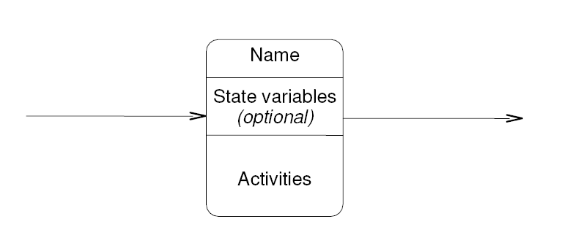
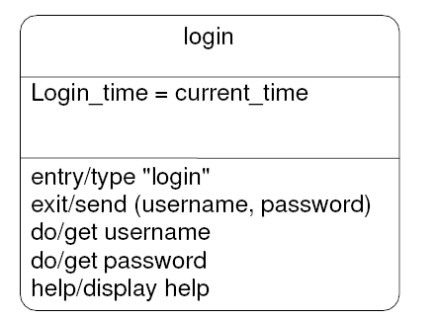

Slide 66
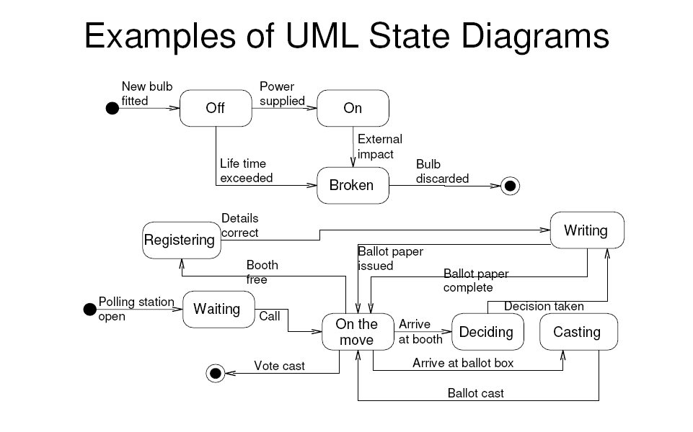

Slide 67
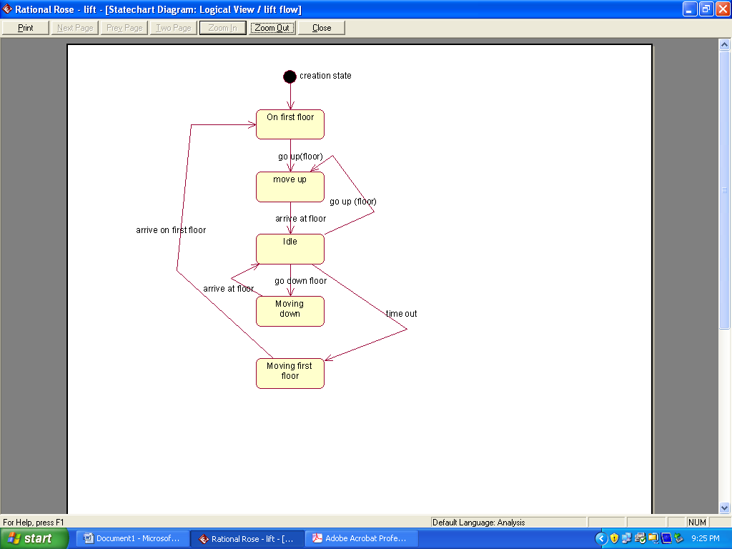
LIFT STATE-CHART DIAGRAM

Slide 68
WORKSHOP EXERCISE 7
A class named “campaign” is textually described
as follows:
“Once a campaign is established, it is assigned a manager and
staff. Authorisation in the form of a signed contract and an
authorisation code is required to kick-off an established
campaign. Once a campaign is started it is noted as active. On
completion of an active campaign, accountability is carried out
in the form of preparation of final statements. Once payment is
received in full, a campaign is considered paid, is archived and
any assigned personnel is released. If payment is only effected
in part, the campaign is not considered paid but rather simply
completed. If any payments were effected in advance of
campaign completion and are in excess of the final payment
request, a refund should be issued.
Draw a UML state diagram for the above system.

Slide 69
WORKSHOP EXERCISE 8
Assuming that a microwave oven is analysed as the following
objects:
• Oven
• Light
• Emission tube
• Timer
The main actions associated with the microwave oven are as
follows:
• Opening the door
• Closing the door
• Using the control button
• Completion of the prescribed cooking interval
Open the door, insert the food, close the door set the 1-minute
timer, wait for cooking to complete, open the door and retrieve the
food.
Create a state diagram for the above scenario.

Slide 70
SEQUENCE DIAGRAM
An interaction is an important sequence of interactions between objects. Rational Rose provides two alternate views or representations of each interaction- a collaboration and a sequence diagram. Collectively they are referred to as interaction diagrams.
Main difference between sequence and collaboration diagram is that sequence diagrams show time-based object interaction while collaboration diagrams show how objects associate with each other.
You can specify and modify an interaction with either kind of diagram, or with both. Rational Rose automatically reflects all changes made either to a sequence or collaboration diagram in the corresponding collaboration or sequence diagram, if one has been created.

Slide 71
Creating and Displaying an Interaction Diagram
To create or display a collaboration or sequence diagram:
1 Click Browse > Interaction Diagram.
The Select Interaction Diagram dialog box is displayed.
2 Select a package to “own” the diagram.
3 On the right side of the dialog box, click the diagram name, and then click OK.
4 From the New Interaction Diagram dialog box, enter the diagram title and click the diagram type. Your choices are Sequence or Collaboration.

Slide 72
SEQUENCE DIAGRAM
A sequence diagram is a graphical view of a scenario that shows object interaction in a time-based sequence—what happens first, what happens next. Sequence diagrams establish the roles of objects and help provide essential information to determine class responsibilities and interfaces. Sequence diagrams are normally associated with use cases.
This type of diagram is best used during early analysis phases in design because they are simple and easy to comprehend. A sequence diagram has two dimensions: typically, vertical placement represents time and horizontal placement represents different objects.

Slide 73
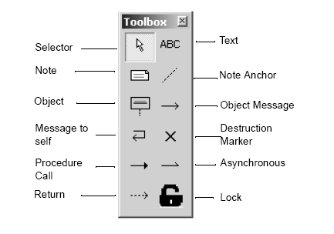
SEQUENCE DIAGRAM TOOLBOX
A sequence diagram traces the execution of a scenario in time.

Slide 74
MAIN POINTS
Used to show object interaction
• Interaction takes the form of messages
• Can only model single-scenario situations
• Message type is one of the interaction types (i.e. synchronous, simple, etc. – see next slide)
• Sequence diagrams should be read starting from the top downwards
• Sequence diagrams highlight control focus in objects (i.e. object activation)
• Sequence diagrams can be either of “instance” or of “generic” form

Slide 75
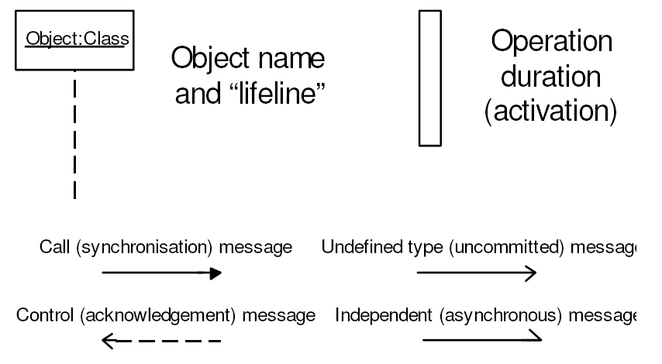
SYMBOLS

Slide 76
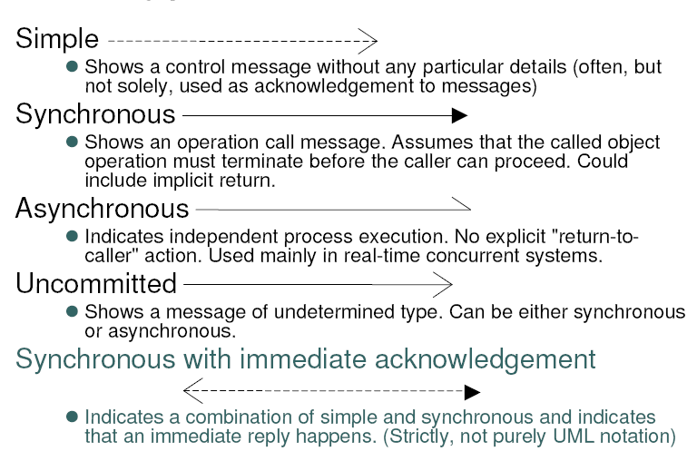
RELATIONSHIPS

Slide 77
TO CREATE A SEQUENCE DIAGRAM
1. Set the context (i.e. scope the system)
2. Identify participating objects
3. Draw arbitrary lifelines for each class
4. Draw the duration of the objects on the
class lifeline
5. Insert the object messages from top to
bottom of diagram (time-based)
6. Check the diagram for completeness

Slide 78
WORKSHOP EXERCISE 9
Draw up a sequence diagram modelling the case when an advert campaign manager retrieves the details of a particular client’s advertising campaign and lists the details of a particular advert from the campaign. The sequence diagram should also show the case when a new advert is created. Only call messages (synchronous) should be used in this example and use any iteration conditions as you deem necessary. Objects to use: “CampainManager”, “Client”, “Campaign”, and “Advert”

Slide 79
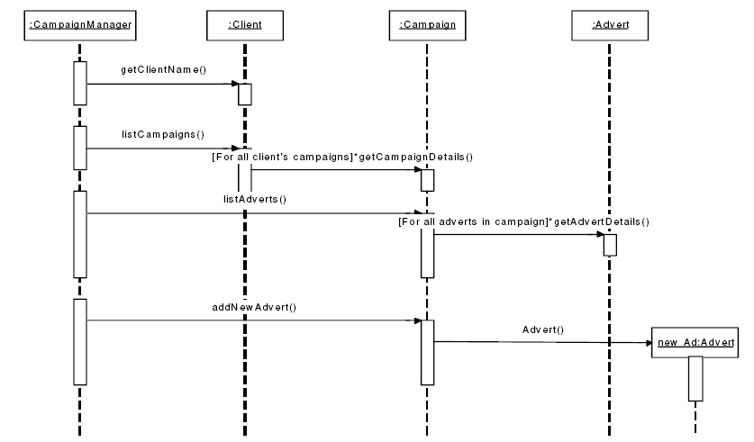
SOLUTION:

Slide 80
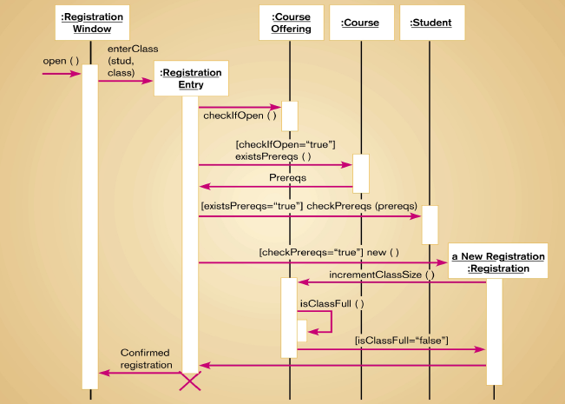
WORKSHOP EXERCISE 10

Slide 81
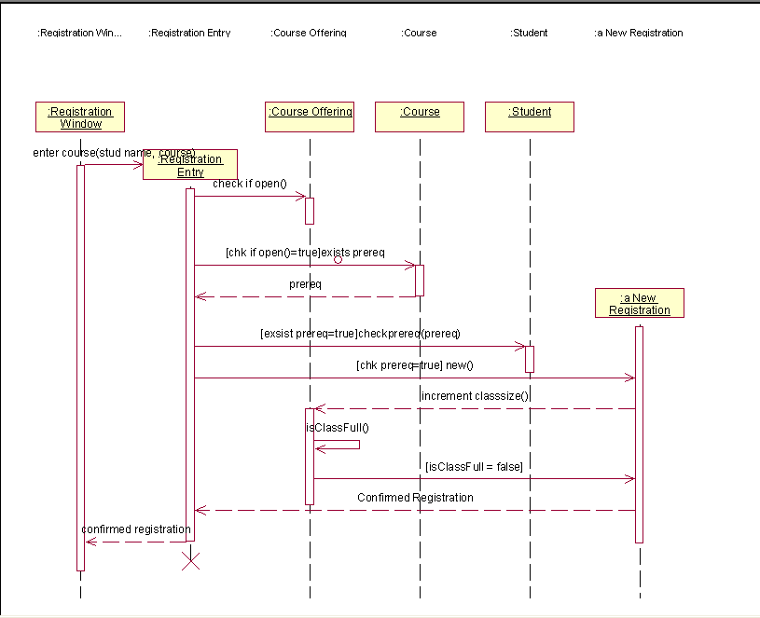

Slide 82
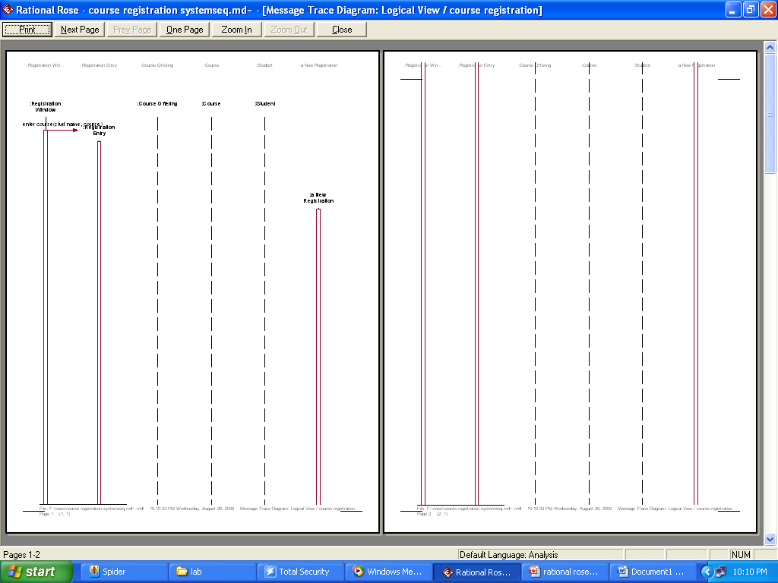

Slide 83
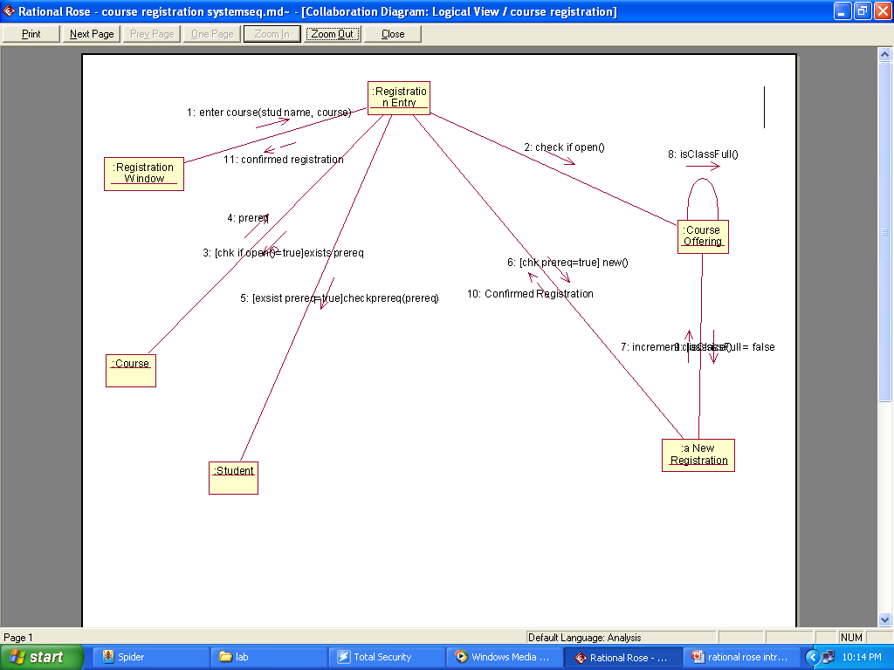
AUTO-GENERATED COLLABORATION DIAGRAM

Slide 84
COLLABORATION DIAGRAM
• Show interactions between collaborating (interacting) objects.
• A bit like a cross between a class and a sequence diagram (object diagram with msgs)
• Are mainly a design tool
• Collaboration diagrams are not time-ordered
• Can serve as basis for a sequence diagram
• Like sequence diagrams, collaboration diagrams employ message passing.

Slide 85
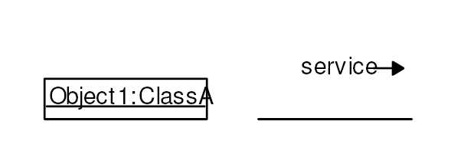
SYMBOLS FOR COLLABORATION
Service:
Sequence-number:[condition]:message(parameter)
A return value can be shown as an assigned “:=“ expression
Sequence-number is a decimalised value (e.g. 1, 1.3, 2.3.1, etc.)

Slide 86
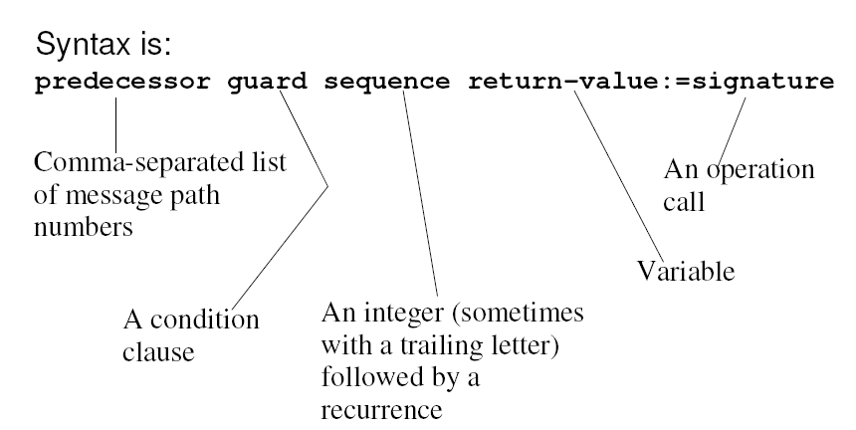
SYNTAX:

Slide 87
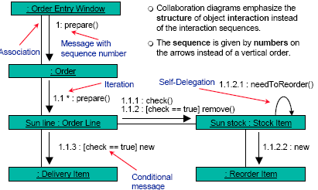
EXAMPLE:

Slide 88
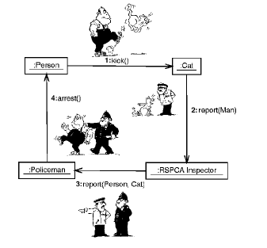
FUN EXAMPLE

Slide 89
USES:
Collaboration diagrams are often used to:
Provide a birds-eye view of a collection of collaborating objects, particularly within a real-time environment.
Allocate functionality to classes by exploring the behavioral aspects of a system.
Model the logic of the implementation of a complex operation, particularly one that interacts with a large number of other objects.
Explore the roles that objects take within a system, as well as the different relationships they are involved with when in those roles.

Slide 90
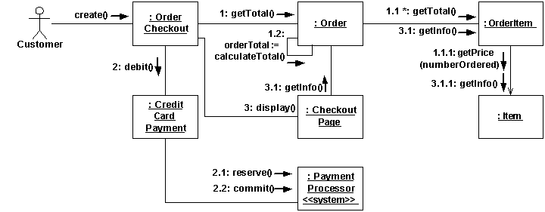
WORKSHOP EXERCISE 11

Slide 91
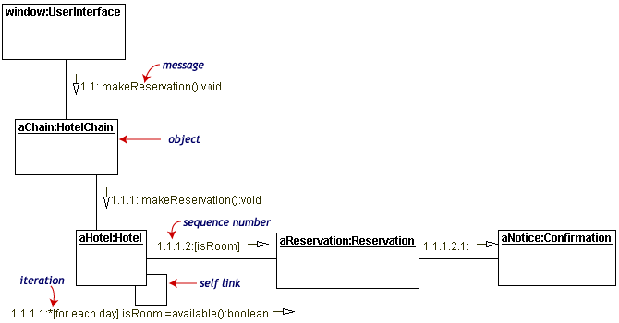
WORKSHOP EXERCISE 12

Slide 92
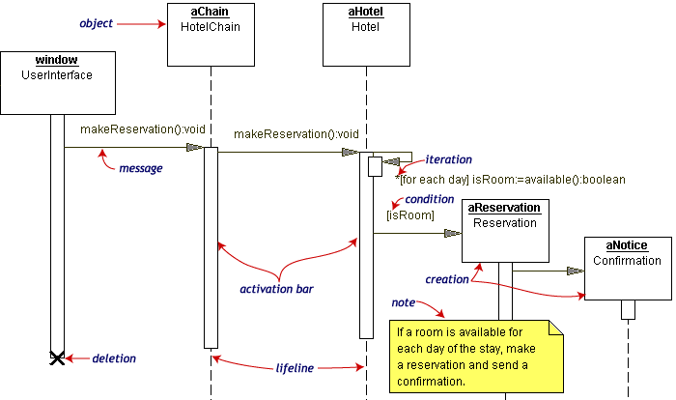
MATCHING SEQUENCE

Slide 93
IMPLEMENTATION DIAGRAMS
show aspects of physical implementation:
Structure of components.
Run-time deployment systems.
Two diagram types:
Component diagram – show the structure of components, including the classifiers that specify them and the artifacts that implement them.
Deployment diagram - show the structure of the nodes on which the components are deployed.
These two diagrams are usually drawn together.

Slide 94
IMPLEMENTATION DIAGRAMS NOTATIONS
Node- A physical object that represents a processing
resource. generally, having at least a memory and often
processing capability as well.
Component- represents a modular, deployable, and replaceable part of a system that encapsulates implementation and exposes a set of interfaces.

Slide 95
COMPONENT DIAGRAM
• Models parts of software and their interdependencies
• Represents code structure
• Are generally implemented in physical terms as “files”, Come as either “source”, “binary”, or “executable” components
• ONLY executable type components can be instantiated
Components are generally physical parts of a system and refers to the implementation platform for the system.

Slide 96
Predefined Component Diagram Stereotypes
• File – Usually a source code file
• Binary / Library – Usually a compiled segment directly linkable into other compilations
• Executable – Usually a directly executable module
• Table – Usually a database table
• Page – Usually a Web page
• Document – Usually a documentation file (as opposed to compilable code)

Slide 97
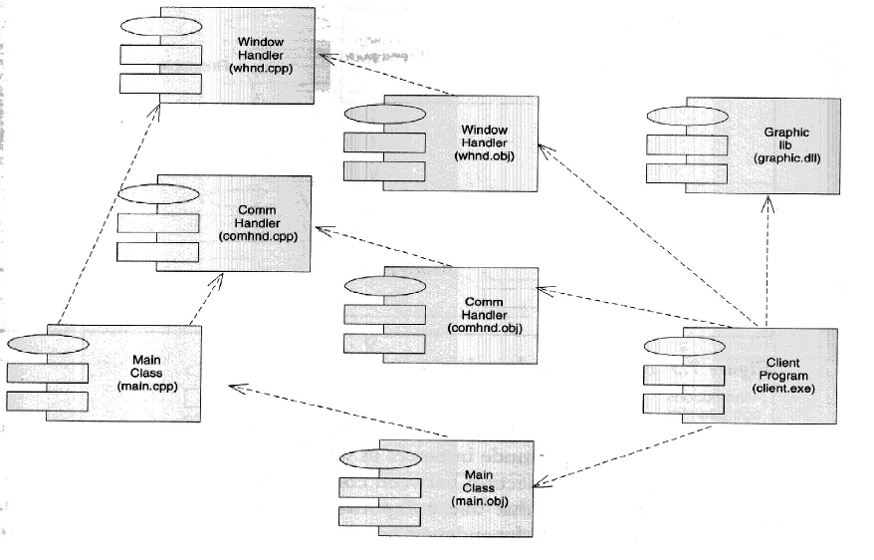
COMPONENT DIAGRAM EXAMPLE

Slide 98
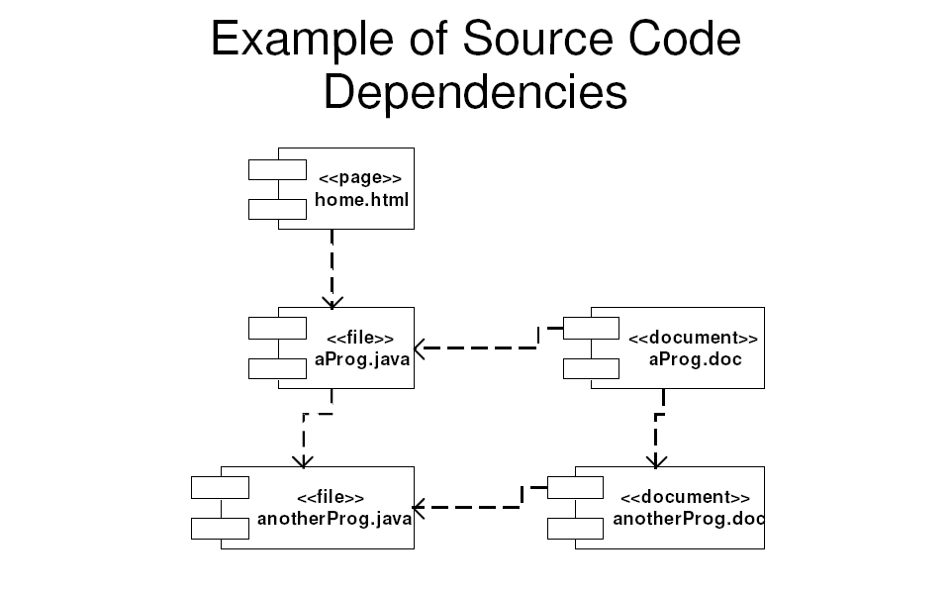
WORKSHOP EXERCISE 13

Slide 99
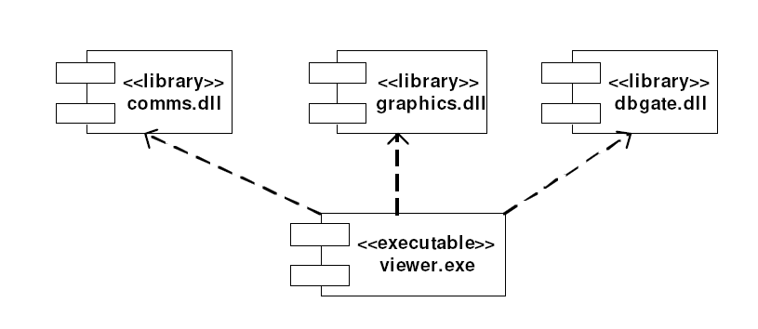
RUNTIME COMPONENT EXAMPLE

Slide 100

UML DEPLOYMENT DIAGRAMS
• Models the run-time architecture (topology) of:
• Processors
• Devices
• Software components
• Is ultimately traceable to initial requirements

Slide 101
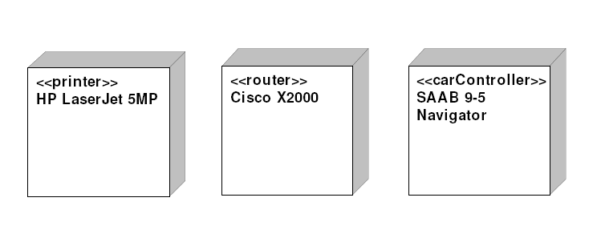
STEREOTYPE EXAMPLES IN DEPLOYMENT DIAGRAMS

Slide 102
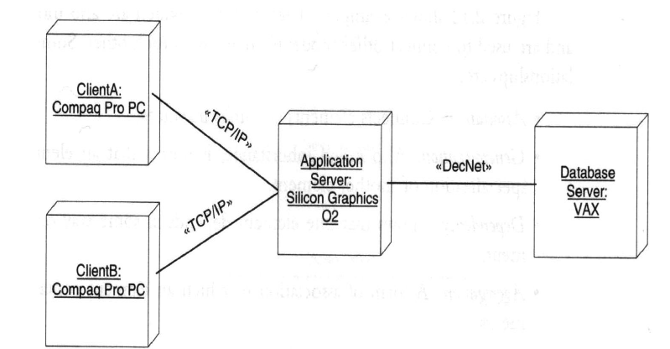
WORKSHOP EXERCISE 14

Slide 103
